Slide 1
Introduction to Git and GitHub
CS102

Slide 2
Warning
You can stop me and ask questions at any time
Notes:
Created out of necessity

Slide 3
Old way of sharing files
Problems with the old way of sharing project files as a zip folder
Synchronization issues with sharing codes of the project
Cannot keep track of whom did what change
Cannot revert/discard accidental changes especially when you realize them later
Notes:
Created out of necessity

Slide 4
Version Control
System that records changes over time
System where collaboration of people is easy
System that keeps the code / files related to the project synchronized

Slide 5
Version Control Systems used in industry
Git
Subversion
Bitbucket
Mercurial
Plastic SCM

Slide 6
Git and GitHub
Free
Decentralized
Faster to commit
Reliable
Good way of showing your work to recruiters in the future

Slide 7
Instructions on opening a GitHub account
Go to https://github.com/
(Optional) Use your student id to get the GitHub Student Developer pack: https://bit.ly/3cCxDmg
Amazing perks of having a GitHub Student Developer pack: https://education.github.com/pack

Slide 8
Instruction on installing Git
To work with GitHub you will need Git installed on your PC
You may need to use the terminal to install if you are using MacOS or Linux
Follow the installation of Git for your operation from: https://github.com/git-guides/install-git

Slide 9
Glossary of terms used in Git from GitHub glossary documentation
Repository is a folder with .git extension that tracks all changes to files within a project
Remote repository is the copy of the repository on the Github.com.
Local repository is the copy of the repository on your computer.
A clone is a copy of a repository that lives on your computer instead of on a website's server somewhere, or the act of making that copy.
A branch is a parallel version of a repository.
A fork is a personal copy of another user's repository that lives on your account
Pull requests are proposed changes to a repository submitted by a user and accepted or rejected by a repository's collaborators.
Notes:
Only owners can create branch, to contribute to large library you should create fork

Slide 10
Glossary continued
The default development branch is a master or main branch. Whenever you create a Git repository, a branch named "master" or “main” is created, and becomes the active branch.
Stage is a state of a project under version control system.
A commit, or "revision", is an individual change to a file (or set of files).
To push means to send your committed changes TO a remote repository on GitHub.com.
Pull means you are fetching in changes FROM the remote repository on Github.com.
Merging takes the changes from one branch or commit (in the same repository or from a fork), and applies them into another.
Merge conflicts happen when people make different changes to the same line of the same file, or when one person edits a file and another person deletes the same file.
README is a text file containing information about the files in a repository that is typically the first file a visitor to your repository will see.
Notes:
Commit is an object that holds changes to various files

Slide 11
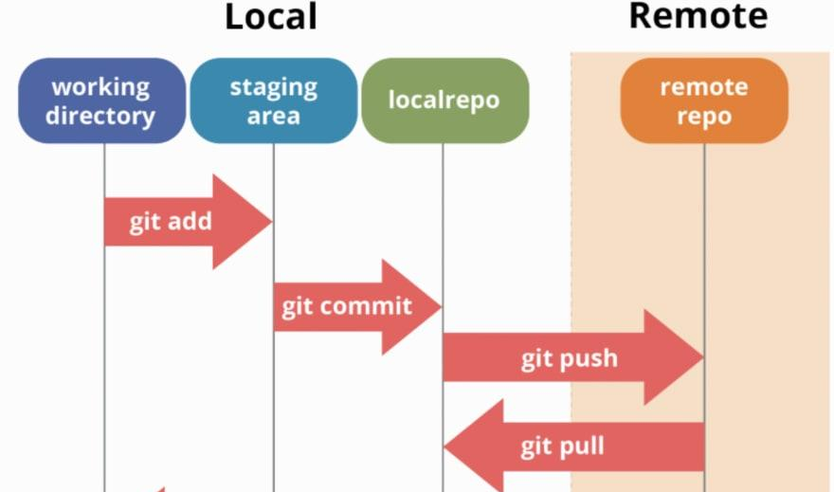
Putting it all together
Source: https://dev.to/mollynem/git-github--workflow-fundamentals-5496

Slide 12
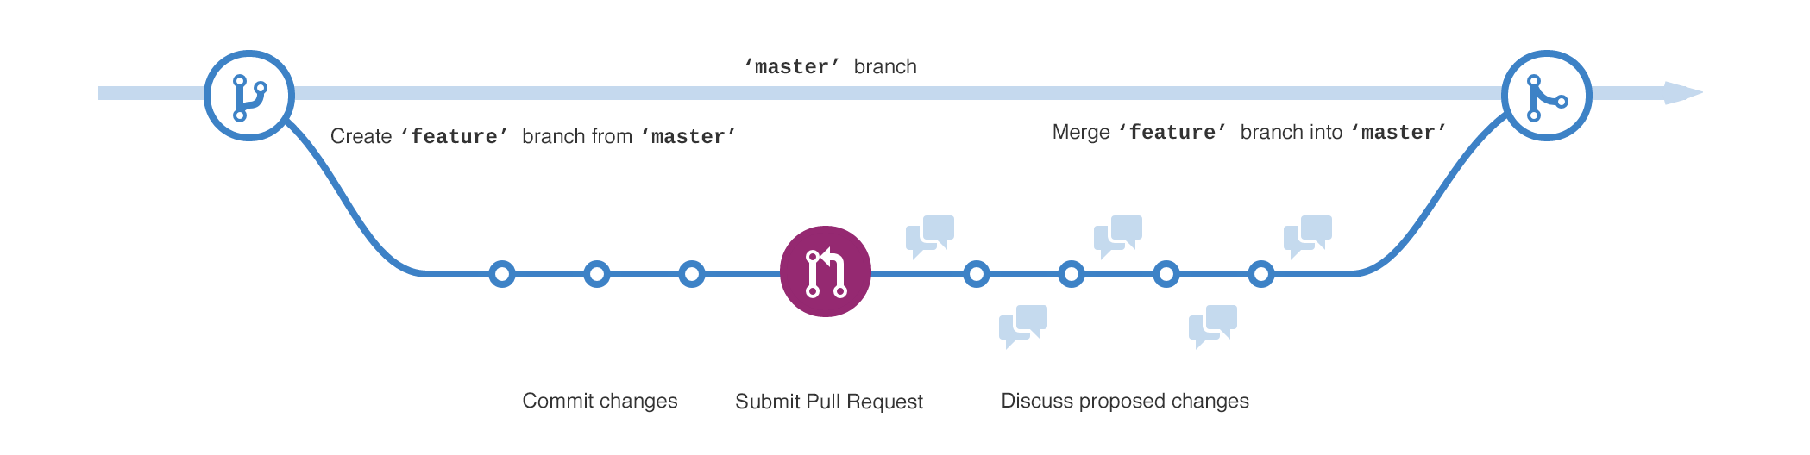
Putting it all together cntd
Source: https://guides.github.com/activities/hello-world/branching.png
Notes:
Accumulating commits in the branch
Creating new branch is not possible always requires ownership, create a fork
Adding multiplayer feature

Slide 13
Simple Git commands developer should know
git init - to initialize the project
git clone {{remove_brackets and insert repo link}} - to clone the project
Create a .gitignore file to make sure that files that are private or large will not be managed by git
If you don’t have a shortcut for remote repository set, then use: git remote set-url origin {{remove_brackets and insert repo link}}
git add . - staging all file
git commit -m “commit_message” - changing the stage of the files in the local repository
git push origin main- pushing your latest changes to the main branch of the remote repository
git pull origin main- get the updates that were pushed to the main branch remote repository
For more git commands you can refer to: https://education.github.com/git-cheat-sheet-education.pdf

Slide 14
Keep in Mind
You cannot push your changes without pulling latest changes from the server
Otherwise, the Git will warn you saying “Git Push Failed”

Slide 15
GitHub Issues
Easy way of maintaining problems and future todos related to the project
Ability to assign issues to other developers in the project
Issues can be tagged in the commit to the project

Slide 16
Github Wiki
To document many aspects of the software
Keep track of your progress
Record your personal log

Slide 17
GitKraken
How to install: https://support.gitkraken.com/how-to-install/
Built-in merge tool
Good visualization of the workflow

Slide 18
Want to learn more?
Take an awesome Udacity course for free with video explanations of the concepts: https://classroom.udacity.com/courses/ud123

Slide 19
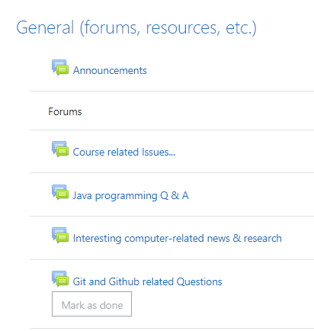
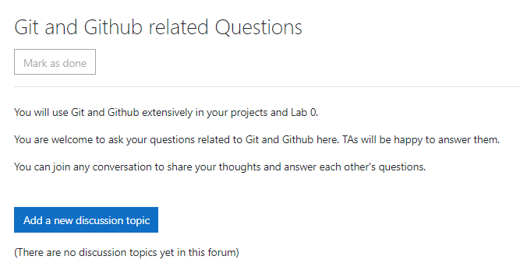
Want to ask more?

Slide 20
Demo of the simple Git and GitHub workflow
Tracking a simple web project to show in practice how does everything work with Git.

